Slide 1
Conceptual framework of costs, benefits and risks of Agro-climate information
interventions in Dien Bien Province, Vietnam
Benefits of interventions
Agro-climate interventions
Implementation
Costs of interventions
Risk
Not accurate- forecasts
Dis-adoption
Hydro-met stations
Forecasts
Translation forecasts into agro-advisories
Dissemination (SMS/loud speaker)
Use
Advisories
Gender
M&E
Reduced inputs, losses
Increased yields
Reduced water pollution
and
Fish death
Improved income from gender equality
Staff’s advice,
Farmers’
Health expense
Total Costs
Discount rate
Total Benefits
Cost
Total and stakeholders’
NPV
Benefit
Risk
Discount rate

Slide 2

Which ACIS solutions that CARE should advocate Dien Bien People Committee to invest for implementation?
Less comprehensive?
Comprehensive?
Simplified?
More simplified?
Notes:
Business as usual
General trainings on agriculture production
Bulletin provision for disease prevention and control, not specific for weather conditions

Slide 3
Which ACIS solutions that CARE should advocate Dien Bien People Committee to invest for implementation?
No | Solution 1 | Solution 2 | Solution 3 | Solution 4
1 | Establish additional station in Muong Ang | Use the existing system to generate climate data | Use the existing system to generate climate data | Use the existing system to generate climate data
2 | Provide seasonal and weekly forecasts Monitor quality of forecasts | Provide seasonal and weekly forecasts Monitor quality of forecasts | Provide seasonal and weekly forecasts Monitor quality of forecasts | Provide seasonal and weekly forecasts Monitor quality of forecasts
3 | Set up district agro-climate technical coordination groups and operation | Set up district agro-climate technical coordination groups and operation | Set up district agro-climate technical coordination groups and operation | Set up district agro-climate technical coordination groups and operation
4 | Build capacity for agriculture staff: meteorology basic, translation into agro-advisories, bulletin edit | Build capacity for agriculture staff: meteorology basic, translation into agro-advisories, bulletin edit | Build capacity for agriculture staff: meteorology basic, translation into agro-advisories, bulletin edit | Build capacity for agriculture staff: meteorology basic, translation into agro-advisories, bulletin edit
5 | Set up SMS dissemination system Monitor, use data from SMS system | Set up SMS dissemination system Monitor, use data from SMS system | Dissemination via loudspeaker system + village meeting using existing system + SMS | Dissemination via loudspeaker + village meeting using existing system
6 | Engage Sub-Government Units in the implementation (People Committee, commune extension workers and village leader) | Engage Sub-Government Units in the implementation (People Committee, commune extension workers and village leader) | Engage Sub-Government Units in the implementation (People Committee, commune extension workers and village leader) | Engage Sub-Government Units in the implementation (People Committee, commune extension workers and village leader)
7 | Gender: Balance and SAA | Gender: Balance and SAA | Gender: Balance | Gender: Balance

Slide 4

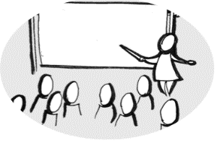



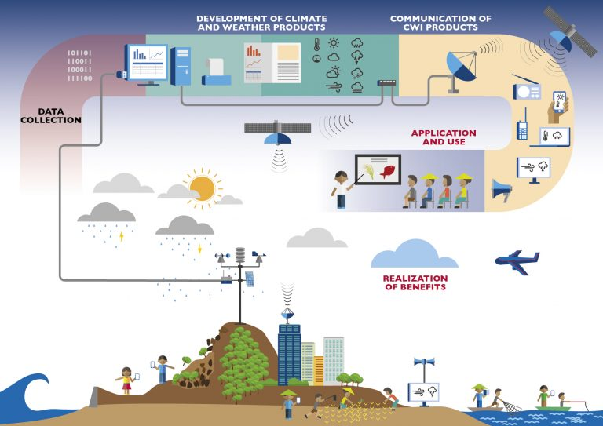


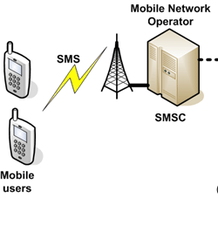


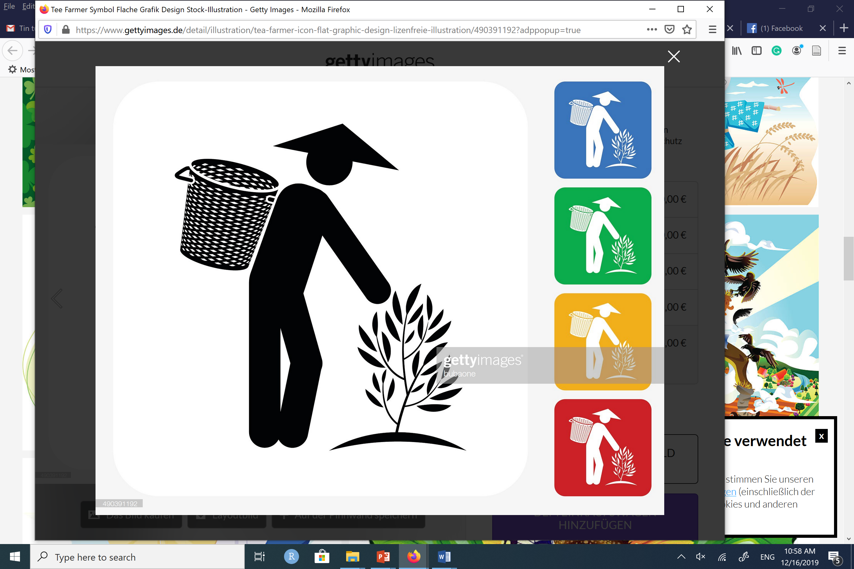




Which options to advocate for investment?
Option #1
Capacity building
Subscribers’ info
Advisories
Forecasts
SMS
Dien Bien
Feedbacks
SMS logs, feedbacks
Muong Ang
Forecasts
Monitoring
Translation into advisories
Use of information
Subscribers’ info., Feedbacks
Gender dialogue and sensitiveness
Subscribers’ info.
Sub-Gov Units, NGO engagement
Notes:
https://www.vectorstock.com/royalty-free-vector/business-meeting-sketch-vector-2850121
https://en.wikipedia.org/wiki/Global_temperature_record
http://www.ozekisms.com/index.php?owpn=368
https://www.gettyimages.de/detail/illustration/tea-farmer-icon-flat-graphic-design-lizenfreie-illustration/490391192?adppopup=true
https://www.google.com/search?q=rice+drawing&sxsrf=ACYBGNSEO1Ytn7WU0_oJATOGi5zV-ZbVbQ:1576491829330&source=lnms&tbm=isch&sa=X&ved=2ahUKEwjZ0unb-bnmAhVK2aQKHSRDDNQQ_AUoAXoECA0QAw&biw=1368&bih=748&dpr=2#imgrc=LXPize0mVFd3zM
https://www.google.com/search?q=temperature+graph&client=firefox-b-d&sxsrf=ACYBGNSTsCN0SIL0gK5HmwQFaJGKnnIysg:1576491556307&source=lnms&tbm=isch&sa=X&ved=2ahUKEwig1NHZ-LnmAhWD_KQKHU6ZBQUQ_AUoAXoECA0QAw&biw=1368&bih=748#imgrc=UuT-xAx6VaT0_M

Slide 5

Which options to advocate for investment? Who involves?
Option #1
Capacity building
{by Provincial Department of Agriculture and Rural Development}
Subscribers’ info
Advisories
Forecasts
SMS
Dien Bien
Feedbacks
SMS logs, feedbacks
Forecasts
Monitoring
{Mobile Network Operator}
Use of information
Muong Ang
Translation into advisories
{Women, men}
{District technical working group}
{District observation points}
{Provincial Met station}
Subscribers’ info., Feedbacks
Gender dialogue and sensitiveness
{Women Union, CCD}
{Department of Agriculture and Rural Development}
Subscribers’ info.
{District Agri. Extension Center}
Sub-Gov Units, NGO engagement
{Commune People Committee, extension workers, village heads, Women Union, CCD}
{Provincial People Committee}
{District People Committee}
Notes:
https://www.vectorstock.com/royalty-free-vector/business-meeting-sketch-vector-2850121
https://en.wikipedia.org/wiki/Global_temperature_record
http://www.ozekisms.com/index.php?owpn=368
https://www.gettyimages.de/detail/illustration/tea-farmer-icon-flat-graphic-design-lizenfreie-illustration/490391192?adppopup=true
https://www.google.com/search?q=rice+drawing&sxsrf=ACYBGNSEO1Ytn7WU0_oJATOGi5zV-ZbVbQ:1576491829330&source=lnms&tbm=isch&sa=X&ved=2ahUKEwjZ0unb-bnmAhVK2aQKHSRDDNQQ_AUoAXoECA0QAw&biw=1368&bih=748&dpr=2#imgrc=LXPize0mVFd3zM
https://www.google.com/search?q=temperature+graph&client=firefox-b-d&sxsrf=ACYBGNSTsCN0SIL0gK5HmwQFaJGKnnIysg:1576491556307&source=lnms&tbm=isch&sa=X&ved=2ahUKEwig1NHZ-LnmAhWD_KQKHU6ZBQUQ_AUoAXoECA0QAw&biw=1368&bih=748#imgrc=UuT-xAx6VaT0_M

Slide 6
Which options to advocate for investment?
Option #2
Capacity building
Tuan Giao
Subscribers’ info
Advisories
Forecasts
SMS
Dien Bien
Feedbacks
SMS logs, feedbacks
Forecasts
Monitoring
Translation into advisories
Use of information
Muong Ang
Subscribers’ info., Feedbacks
Gender dialogue and sensitiveness
Subscribers’ info.
Sub-Gov Units, NGO engagement
Notes:
https://www.vectorstock.com/royalty-free-vector/business-meeting-sketch-vector-2850121
https://en.wikipedia.org/wiki/Global_temperature_record
http://www.ozekisms.com/index.php?owpn=368
https://www.gettyimages.de/detail/illustration/tea-farmer-icon-flat-graphic-design-lizenfreie-illustration/490391192?adppopup=true
https://www.google.com/search?q=rice+drawing&sxsrf=ACYBGNSEO1Ytn7WU0_oJATOGi5zV-ZbVbQ:1576491829330&source=lnms&tbm=isch&sa=X&ved=2ahUKEwjZ0unb-bnmAhVK2aQKHSRDDNQQ_AUoAXoECA0QAw&biw=1368&bih=748&dpr=2#imgrc=LXPize0mVFd3zM
https://www.google.com/search?q=temperature+graph&client=firefox-b-d&sxsrf=ACYBGNSTsCN0SIL0gK5HmwQFaJGKnnIysg:1576491556307&source=lnms&tbm=isch&sa=X&ved=2ahUKEwig1NHZ-LnmAhWD_KQKHU6ZBQUQ_AUoAXoECA0QAw&biw=1368&bih=748#imgrc=UuT-xAx6VaT0_M

Slide 7
Which options to advocate for investment? Who involves?
Option #2
Capacity building
{by Provincial Department of Agriculture and Rural Development}
Tuan Giao
Subscribers’ info
Advisories
Forecasts
SMS
Dien Bien
Feedbacks
SMS logs, feedbacks
Forecasts
Monitoring
{Mobile Network Operator}
Use of information
Muong Ang
Translation into advisories
{Women, men}
{District technical working group}
{District observation points}
{Provincial Met station}
Subscribers’ info., Feedbacks
Gender dialogue and sensitiveness
{Women Union, CCD}
{Department of Agriculture and Rural Development}
Subscribers’ info.
{District Agri. Extension Center}
Sub-Gov Units, NGO engagement
{Commune People Committee, extension workers, village heads, Women Union, CCD}
{Provincial People Committee}
{District People Committee}
Notes:
https://www.vectorstock.com/royalty-free-vector/business-meeting-sketch-vector-2850121
https://en.wikipedia.org/wiki/Global_temperature_record
http://www.ozekisms.com/index.php?owpn=368
https://www.gettyimages.de/detail/illustration/tea-farmer-icon-flat-graphic-design-lizenfreie-illustration/490391192?adppopup=true
https://www.google.com/search?q=rice+drawing&sxsrf=ACYBGNSEO1Ytn7WU0_oJATOGi5zV-ZbVbQ:1576491829330&source=lnms&tbm=isch&sa=X&ved=2ahUKEwjZ0unb-bnmAhVK2aQKHSRDDNQQ_AUoAXoECA0QAw&biw=1368&bih=748&dpr=2#imgrc=LXPize0mVFd3zM
https://www.google.com/search?q=temperature+graph&client=firefox-b-d&sxsrf=ACYBGNSTsCN0SIL0gK5HmwQFaJGKnnIysg:1576491556307&source=lnms&tbm=isch&sa=X&ved=2ahUKEwig1NHZ-LnmAhWD_KQKHU6ZBQUQ_AUoAXoECA0QAw&biw=1368&bih=748#imgrc=UuT-xAx6VaT0_M

Slide 8
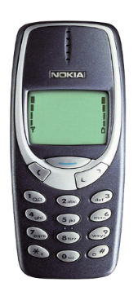

Which options to advocate for investment? Who involves?
Option #3
Capacity building
Village meeting Loudspeaker
SMS
Tuan Giao
Advisories
Forecasts
This week, it is sunny during the day time, no rain, temperature from 21-33 degree Celcius. Farmers should weed, check and treat for rice Brown planhopper and Rice leaf folder
Dien Bien
Feedbacks
Feedbacks
Muong Ang
Forecasts
Monitoring
Translation into advisories
Use of information
Feedbacks
Gender balance
Sub-Gov Units, NGO engagement
Notes:
https://www.vectorstock.com/royalty-free-vector/business-meeting-sketch-vector-2850121
https://en.wikipedia.org/wiki/Global_temperature_record
http://www.ozekisms.com/index.php?owpn=368
https://www.gettyimages.de/detail/illustration/tea-farmer-icon-flat-graphic-design-lizenfreie-illustration/490391192?adppopup=true
https://www.google.com/search?q=rice+drawing&sxsrf=ACYBGNSEO1Ytn7WU0_oJATOGi5zV-ZbVbQ:1576491829330&source=lnms&tbm=isch&sa=X&ved=2ahUKEwjZ0unb-bnmAhVK2aQKHSRDDNQQ_AUoAXoECA0QAw&biw=1368&bih=748&dpr=2#imgrc=LXPize0mVFd3zM
https://www.google.com/search?q=temperature+graph&client=firefox-b-d&sxsrf=ACYBGNSTsCN0SIL0gK5HmwQFaJGKnnIysg:1576491556307&source=lnms&tbm=isch&sa=X&ved=2ahUKEwig1NHZ-LnmAhWD_KQKHU6ZBQUQ_AUoAXoECA0QAw&biw=1368&bih=748#imgrc=UuT-xAx6VaT0_M

Slide 9
Which options to advocate for investment? Who involves?
Option #3
Capacity building
{by Provincial Department of Agriculture and Rural Development}
Village meeting Loudspeaker
{Village heads}
SMS
{Village heads}
Tuan Giao
Advisories
Forecasts
This week, it is sunny during the day time, no rain, temperature from 21-33 degree Celcius. Farmers should weed, check and treat for rice Brown planhopper and Rice leaf folder
Dien Bien
Feedbacks
Feedbacks
Muong Ang
Forecasts
Monitoring
Translation into advisories
Use of information
{District technical working group}
{Women, men}
{District observation points}
{Provincial Met station}
Feedbacks
Gender balance
{District technical working group}
{Department of Agriculture and Rural Development}
{District Agri. Extension Center}
Sub-Gov Units, NGO engagement
{Commune People Committee, extension workers, village heads, Women Union, CCD}
{Provincial People Committee}
{District People Committee}
Notes:
https://www.vectorstock.com/royalty-free-vector/business-meeting-sketch-vector-2850121
https://en.wikipedia.org/wiki/Global_temperature_record
http://www.ozekisms.com/index.php?owpn=368
https://www.gettyimages.de/detail/illustration/tea-farmer-icon-flat-graphic-design-lizenfreie-illustration/490391192?adppopup=true
https://www.google.com/search?q=rice+drawing&sxsrf=ACYBGNSEO1Ytn7WU0_oJATOGi5zV-ZbVbQ:1576491829330&source=lnms&tbm=isch&sa=X&ved=2ahUKEwjZ0unb-bnmAhVK2aQKHSRDDNQQ_AUoAXoECA0QAw&biw=1368&bih=748&dpr=2#imgrc=LXPize0mVFd3zM
https://www.google.com/search?q=temperature+graph&client=firefox-b-d&sxsrf=ACYBGNSTsCN0SIL0gK5HmwQFaJGKnnIysg:1576491556307&source=lnms&tbm=isch&sa=X&ved=2ahUKEwig1NHZ-LnmAhWD_KQKHU6ZBQUQ_AUoAXoECA0QAw&biw=1368&bih=748#imgrc=UuT-xAx6VaT0_M

Slide 10

Which options to advocate for investment? Who involves?
Option #4
Capacity building
Village meeting Loudspeaker
Correspondence
Tuan Giao
Advisories
Forecasts
Dien Bien
Feedbacks
Feedbacks
Muong Ang
Forecasts
Monitoring
Translation into advisories
Use of information
Feedbacks
Gender balance
Sub-Gov Units, NGO engagement
Notes:
https://www.vectorstock.com/royalty-free-vector/business-meeting-sketch-vector-2850121
https://en.wikipedia.org/wiki/Global_temperature_record
http://www.ozekisms.com/index.php?owpn=368
https://www.gettyimages.de/detail/illustration/tea-farmer-icon-flat-graphic-design-lizenfreie-illustration/490391192?adppopup=true
https://www.google.com/search?q=rice+drawing&sxsrf=ACYBGNSEO1Ytn7WU0_oJATOGi5zV-ZbVbQ:1576491829330&source=lnms&tbm=isch&sa=X&ved=2ahUKEwjZ0unb-bnmAhVK2aQKHSRDDNQQ_AUoAXoECA0QAw&biw=1368&bih=748&dpr=2#imgrc=LXPize0mVFd3zM
https://www.google.com/search?q=temperature+graph&client=firefox-b-d&sxsrf=ACYBGNSTsCN0SIL0gK5HmwQFaJGKnnIysg:1576491556307&source=lnms&tbm=isch&sa=X&ved=2ahUKEwig1NHZ-LnmAhWD_KQKHU6ZBQUQ_AUoAXoECA0QAw&biw=1368&bih=748#imgrc=UuT-xAx6VaT0_M

Slide 11
Which options to advocate for investment? Who involves?
Option #4
Capacity building
{by Provincial Department of Agriculture and Rural Development}
Village meeting Loudspeaker
Correspondence
{Commune PC}
Tuan Giao
Advisories
Forecasts
Dien Bien
Feedbacks
Feedbacks
Muong Ang
Forecasts
Monitoring
Translation into advisories
{Village heads}
Use of information
{District technical working group}
{Women, men}
{District observation points}
{Provincial Met station}
Feedbacks
Gender dialogue and sensitiveness
{District technical working group}
{Department of Agriculture and Rural Development}
{District Agri. Extension Center}
Sub-Gov Units, NGO engagement
{Commune People Committee, extension workers, village heads, Women Union, CCD}
{Provincial People Committee}
{District People Committee}
Notes:
https://www.vectorstock.com/royalty-free-vector/business-meeting-sketch-vector-2850121
https://en.wikipedia.org/wiki/Global_temperature_record
http://www.ozekisms.com/index.php?owpn=368
https://www.gettyimages.de/detail/illustration/tea-farmer-icon-flat-graphic-design-lizenfreie-illustration/490391192?adppopup=true
https://www.google.com/search?q=rice+drawing&sxsrf=ACYBGNSEO1Ytn7WU0_oJATOGi5zV-ZbVbQ:1576491829330&source=lnms&tbm=isch&sa=X&ved=2ahUKEwjZ0unb-bnmAhVK2aQKHSRDDNQQ_AUoAXoECA0QAw&biw=1368&bih=748&dpr=2#imgrc=LXPize0mVFd3zM
https://www.google.com/search?q=temperature+graph&client=firefox-b-d&sxsrf=ACYBGNSTsCN0SIL0gK5HmwQFaJGKnnIysg:1576491556307&source=lnms&tbm=isch&sa=X&ved=2ahUKEwig1NHZ-LnmAhWD_KQKHU6ZBQUQ_AUoAXoECA0QAw&biw=1368&bih=748#imgrc=UuT-xAx6VaT0_M

